Slide 1
Module II - Solar Energy
Introduction to photovoltaic (PV) systems - Principle of PV conversion
Commercial solar cell
Thin film PV device fabrication - LPCVD, APCVD, PECVD, Tandem Solar cell fabrication
Solar power extraction using PV-Cells, I-V Characteristics
PV-Inverters without D.C. to D.C. converters
Standalone and grid-collected PV systems
Grid interfacing-with isolation, without isolation,
Maximum Power Point Tracking Methods(MPPT)
PV-Inverters with D.C. to D.C. converters-on low-frequency side and high frequency side with isolation, without isolation

Slide 2
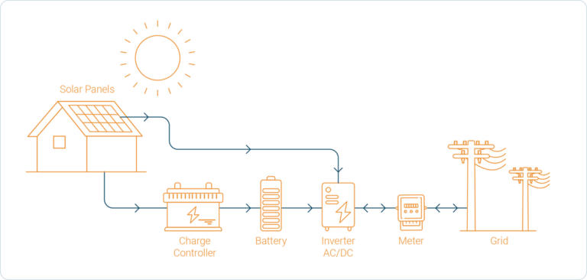
Introduction to photovoltaic (PV) systems
A photovoltaic (PV) system converts sunlight directly into electrical energy using solar cells and associated power‑conditioning components.
DC/AC
Grid-Connected Solar Photovoltaic System Block Diagram

Slide 3
Grid-Connected Solar Photovoltaic System Block Diagram
Grid-interactive solar PV systems generally consist of six individual components: the solar PV array, a charge controller, a battery bank, an inverter, a utility meter, and an electric grid.
However, a charge controller and battery bank are optional.
Even though these two components help you store and, as such, make better use of your generated solar energy, they also increase the total price of the installation.
A solar PV array consists of several solar PV panels that are connected. The solar PV array generates DC electricity from sunlight.
Photovoltaic systems must be installed on stable mounting structures that can support the array and withstand weather conditions like wind, rain, and corrosion.
Most mounting systems are made of aluminium with stainless steel hardware and are designed to accept a variety of solar modules on different roof types.

Slide 4
Charge controllers regulate the DC electricity from the solar panels to prevent the batteries from overcharging.
Charge controllers can be divided into two types: Pulse Width Modulation (PWM) and Maximum Power Point Tracking (MPPT).
The PWM is a standard type and is suitable for smaller photovoltaic systems and battery banks.
MPPT charge controllers are more suitable for larger systems. You only need a charge controller if you have a battery bank.
A battery bank helps you maximise your self-consumption of solar energy and it also provides you with a reliable back-up solution in case of grid outages.
It stores the energy that is being produced by the PV array and is not consumed immediately.
A solar inverter is one of the most important elements of the solar electric power system and it is advised to get a good quality inverter.
It converts the variable direct current (DC) output of a solar PV panel into an alternating current (AC).
This AC electricity can be fed into your home to operate your household appliances.
Depending on how your system is set-up the electricity that is not used in your home is either fed into the grid via electrical power lines or stored in batteries for later use

Slide 5
Bi-directional energy meter
The solar energy that you have generated from the solar PV system and that is not stored or self-consumed will be fed back into the public electricity grid.
Bi-directional meters keep track of (i) the electricity drawn from the public grid and (ii) the surplus solar energy that is exported to the public grid.
Electric grid
Although solar PV is making off-grid electricity sourcing possible, most homeowners, and organization opt for a combination of solar PV- and grid-based electricity sourcing.
If your building is connected to the public grid, the extra power that is generated from your solar PV system, once your battery bank is full, will be sent to the grid.
This also means that during periods (night-time or cloudy days etc.) when the solar PV system doesn’t cover your energy needs, you will be able to supply your home with electricity from the grid.
Depending on which state you are in the exported solar energy will attract monetary compensation either through a net metering, net feed-in or gross feed-in accounting mechanism.

Slide 6
Benefits of a solar PV system
Once properly installed, the system requires minimal maintenance.
It provides you with clean energy and the operation does not create any noise or pollution.
A solar PV system is modular; it is easy to expand or, even, in some cases, transport it.
It will reduce your electricity bill, as running the system is free.
The system is expected to have a lifetime of 20 to 25 years.

Slide 7
Principle of PV conversion
The principle of PV conversion is the photovoltaic effect, where a semiconductor p–n junction converts light energy directly into electrical energy.​
Basic physical idea
A PV cell is made of semiconductor material (commonly silicon), forming a p–n junction with an internal electric field at the junction.​
When photons with energy greater than the bandgap strike the semiconductor, they can be absorbed and create electron–hole pairs in the material.​
Charge separation and current
The built‑in electric field at the p–n junction drives electrons toward the n‑side and holes toward the p‑side, separating the photo‑generated carriers before they recombine.​
This separation produces a potential difference (open‑circuit voltage) between the two sides; when an external circuit is connected, electrons flow through the circuit, giving a photocurrent whose magnitude depends on irradiance, cell area, and material properties.

Slide 8
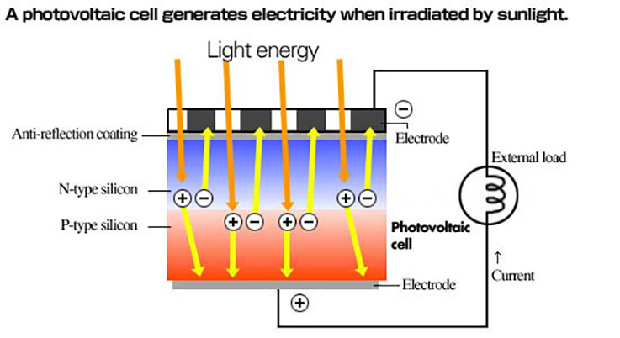
Principle of PV conversion

